Slide 1
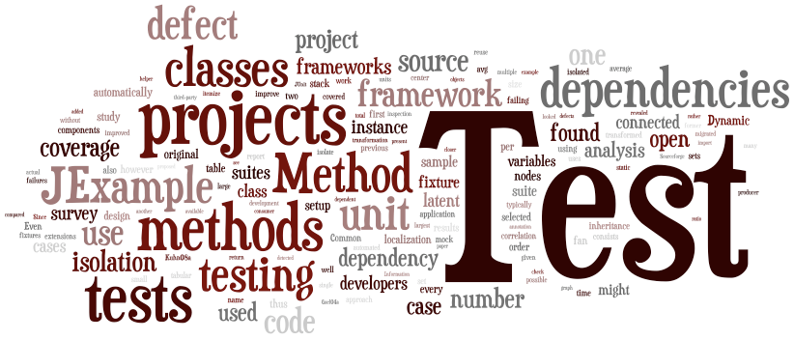
SENG 438 Software Testing, Reliability & Quality
Assignment 2

Slide 2
Assignment 2
Requirement-based testing
SUT - JFreeChart
Requirements
Test design
Test execution

Slide 3
Activities
1st week: Familiarization (setup Eclipse, Junit, mock framework, ensure they work together)
1st week: Writing tests (write test cases and suite for Junit, prepare stubs or mocks)
2nd week: Executing unit test using Junit and demo
2nd week: Reporting the results

Slide 4
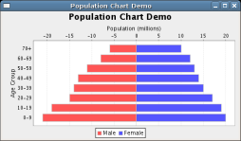
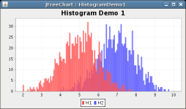
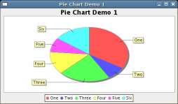
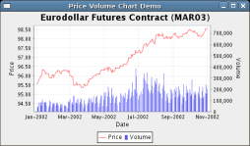
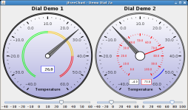
SUT: JFreeChart
The JFreeChart framework is a free/open-source chart library intended to be integrated into other systems as a quick and simple way to add charting functionality to Java applications
http://www.jfree.org/jfreechart

Slide 5
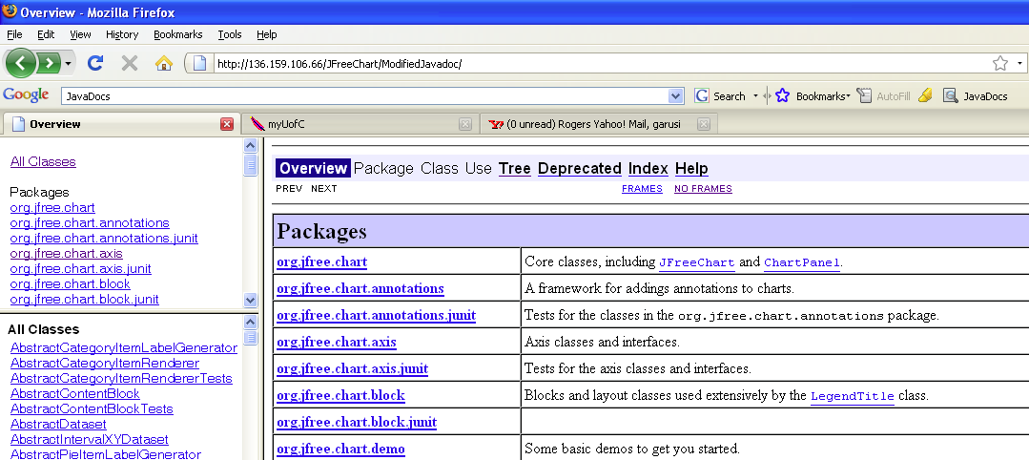
JFreeChart – Requirements
Reminder: SW Requirements can come in many different formats, e.g., plain English, UML models, Javadoc, …
In Assignment 2, we will use the Javadoc documentation of JFreeChart as its requirements
Online now

Slide 6
Test Requirements
JFreeChart classes under test
org.jfree.data.DataUtilities
Has 9 methods
org.jfree.data.Range
Has 19 methods
You have to write tests for 5 methods from each class

Slide 7
Test Design
Equivalence class testing
Boundary value analysis
Robustness testing
Worst case testing

Slide 8
Test Execution
Junit 4
You need to use mocking
For “Values2D” and “KeyedValues”
You are free to choose your mocking framework
Example of JMock tests for the SUT of the Assignment 2 will be given
jMock or any other mocking framework

